Slide 1

Jog Your Memory Adam Ehlers Andrea Pfeffer Joe Goeman Sara Lewer Data Visualization and Analytics Bootcamp March 2022

Slide 2









HTML
CSS
JAVASCRIPT
LEAFLET
Can a trail’s popularity be predicted by its features?

Slide 3
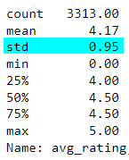
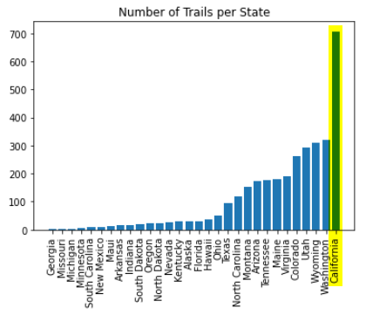
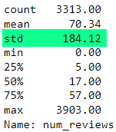
Average Rating Distribution
Number of Reviews Distribution

Slide 4
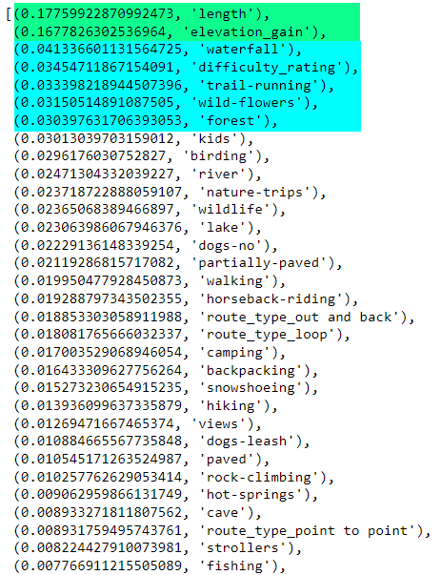
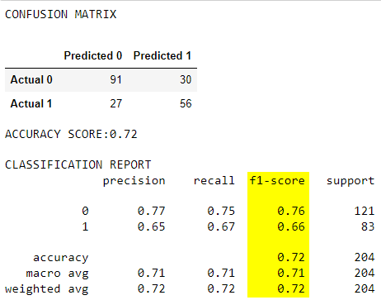
Yes!
A trail’s popularity
can be predicted
on random chance.

